Slide 1
Problem Set 1 Part 1
Submitted by,
Basavraj Jaliminche (8800149)

Slide 2
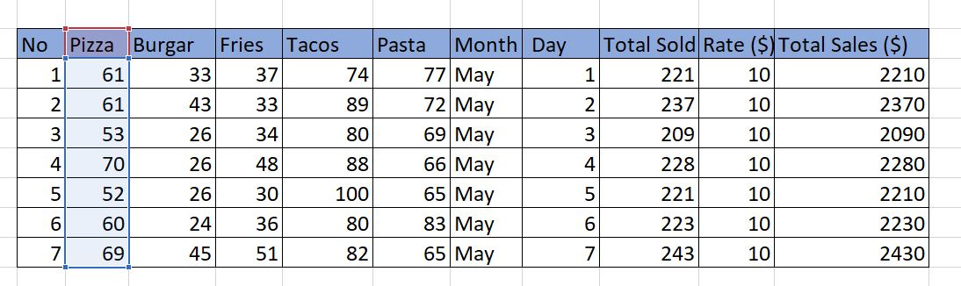
Dataset

Slide 3
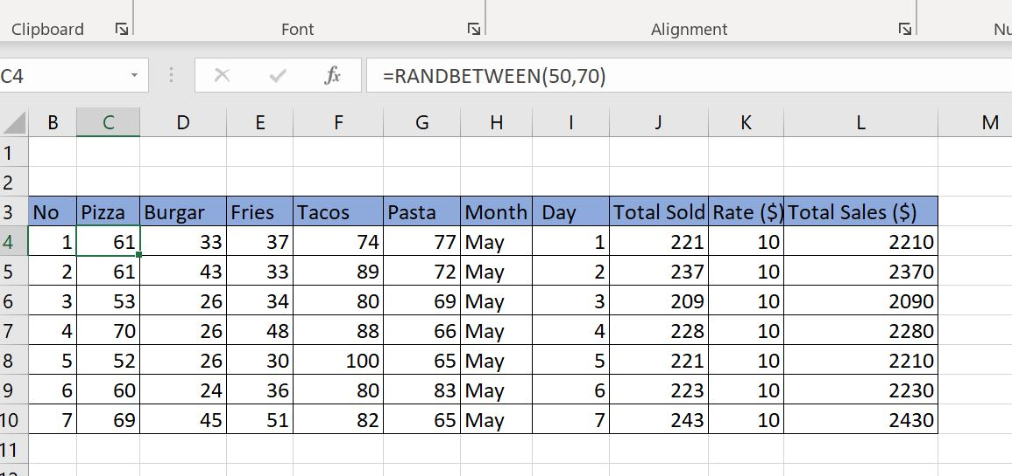
Random Formula Used

Slide 4
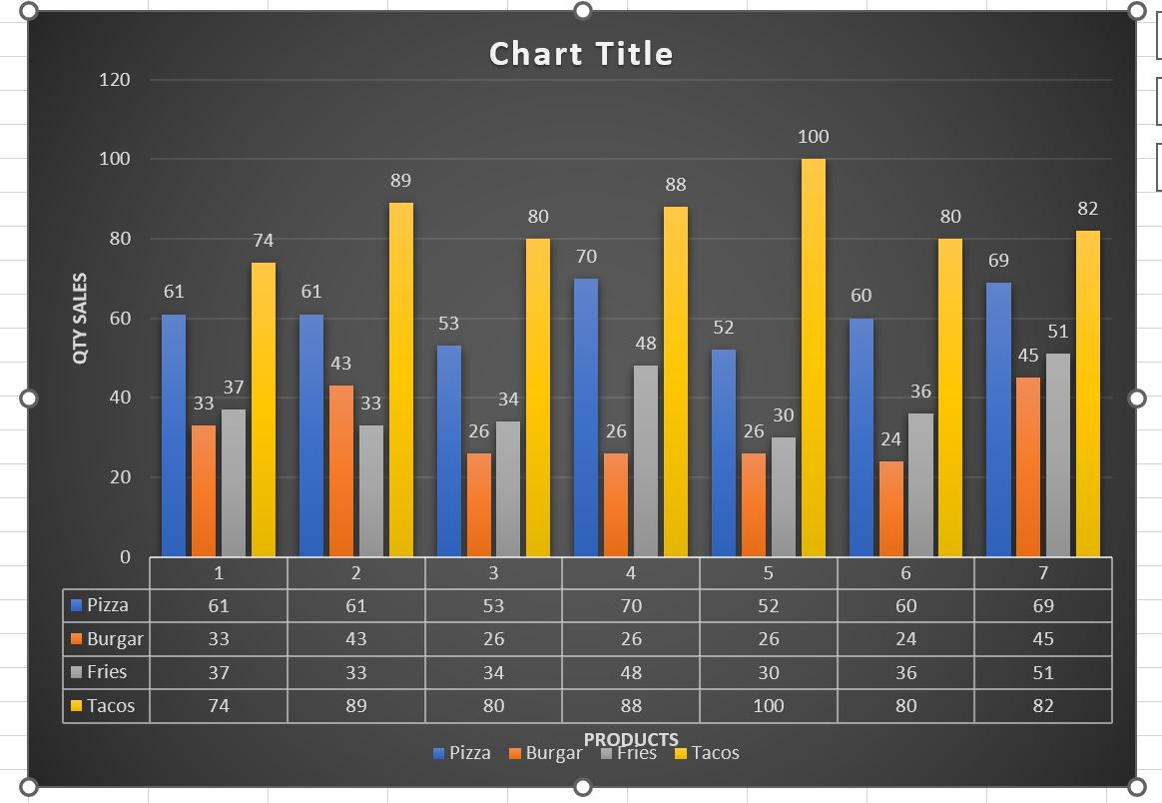
Visualas Created

Slide 5
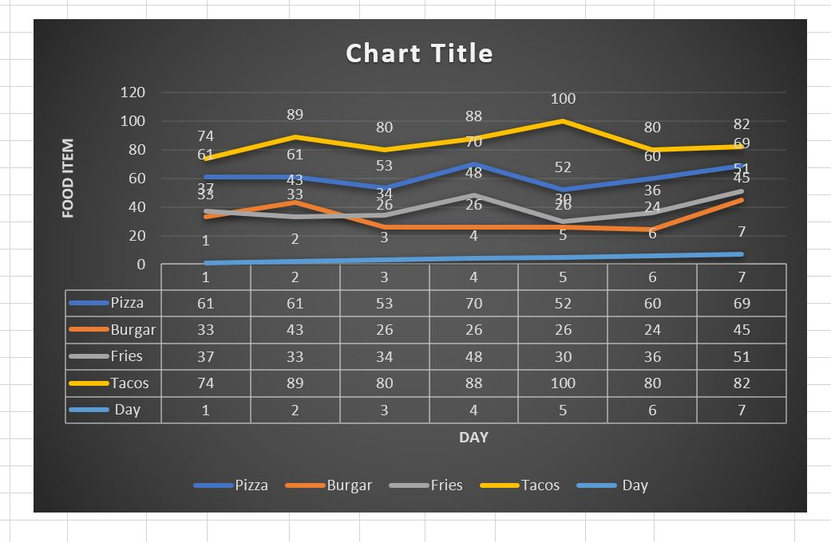
Visual 2

Slide 6
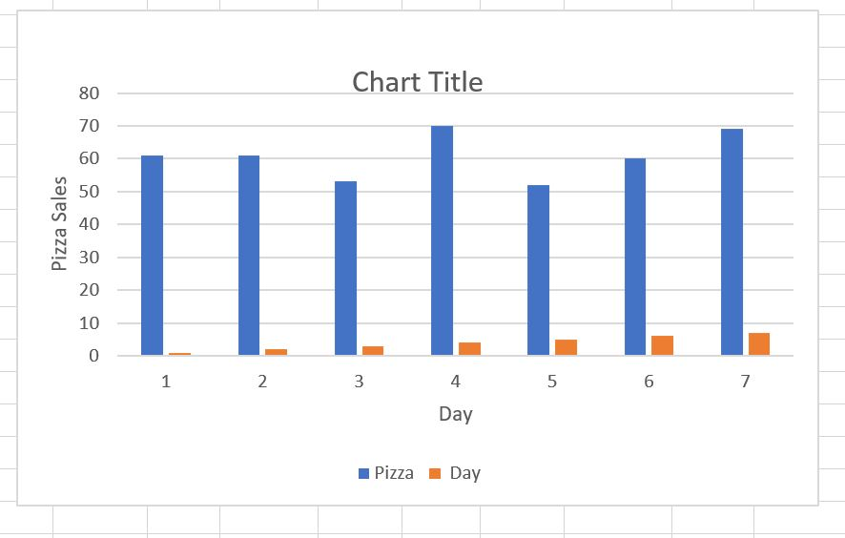
Visual 3
We can create for all food products

